Slide 1
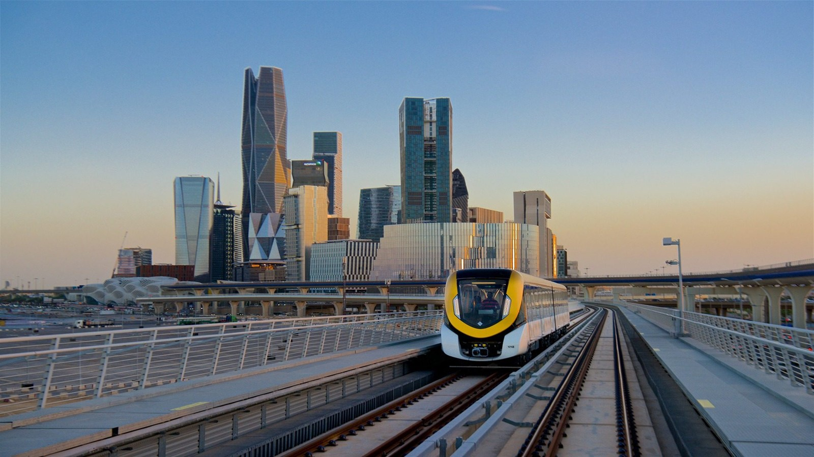
From Dec 2024
To May 2025
Riyadh Metro
Ticket Sales
Data Analysis

Slide 2
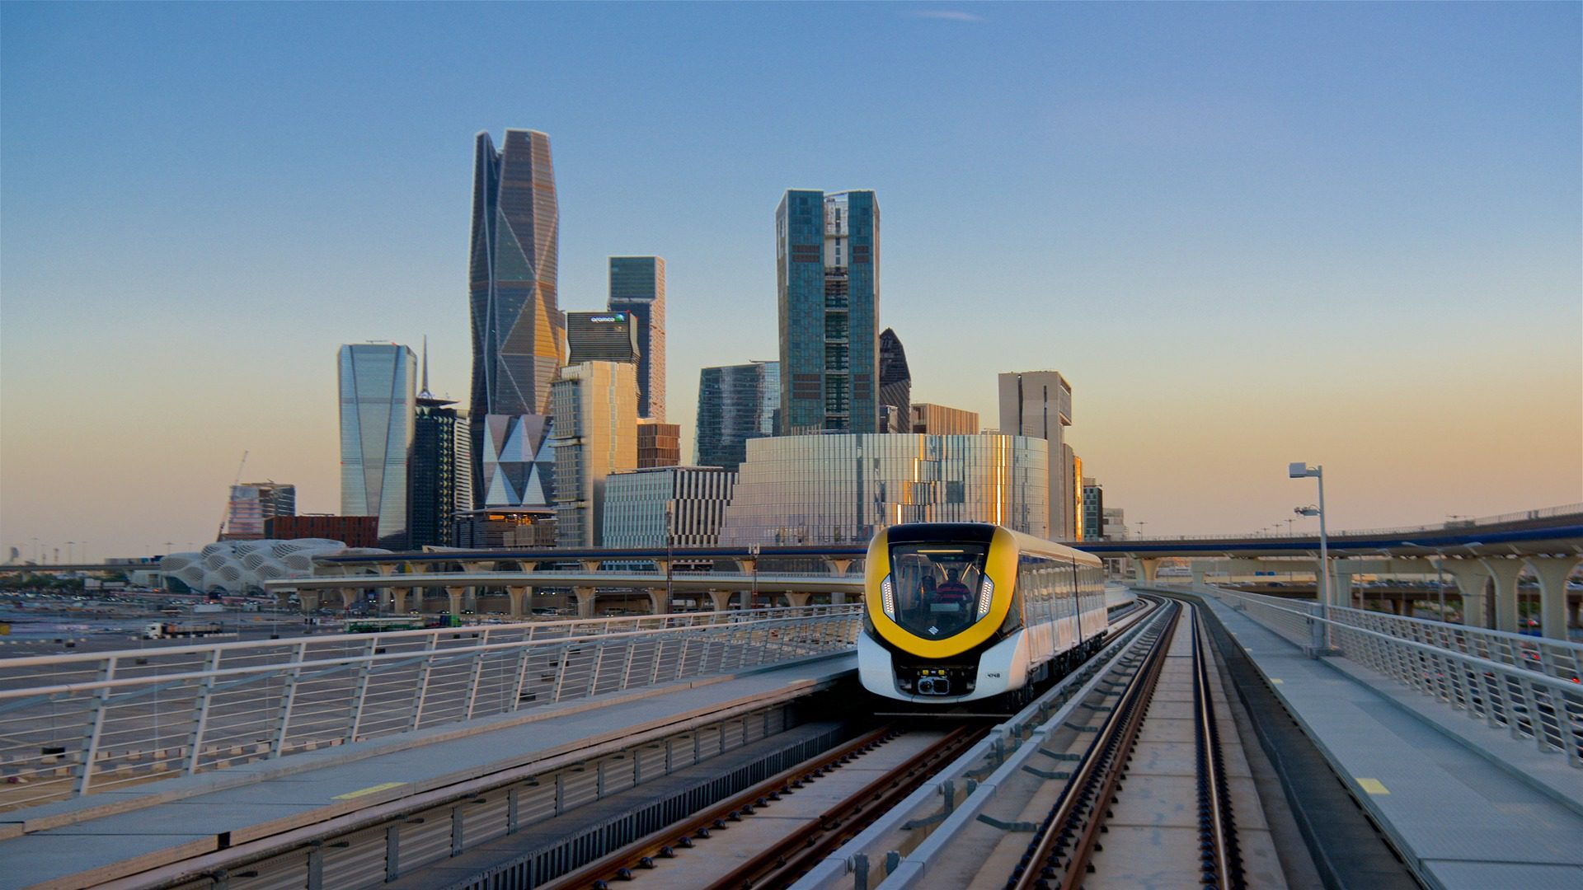
Project Introduction
and Goals:
Analyze ticket sales post-launch
Understanding passenger behavior, accuracy of trip times
pricing efficiency, and patterns of return requests.

Slide 3
Data Collection:
Source: Simulated data.
Number of rows: 10,000
Number of columns: 16 columns

Slide 4
Data Summary:
Convert Journey Date to datetime.
Fill the missing values in the Delay Reason & Gender columns.
No duplicated rows.
No outliers.

Slide 5
Insights and Recommendation:

Slide 6
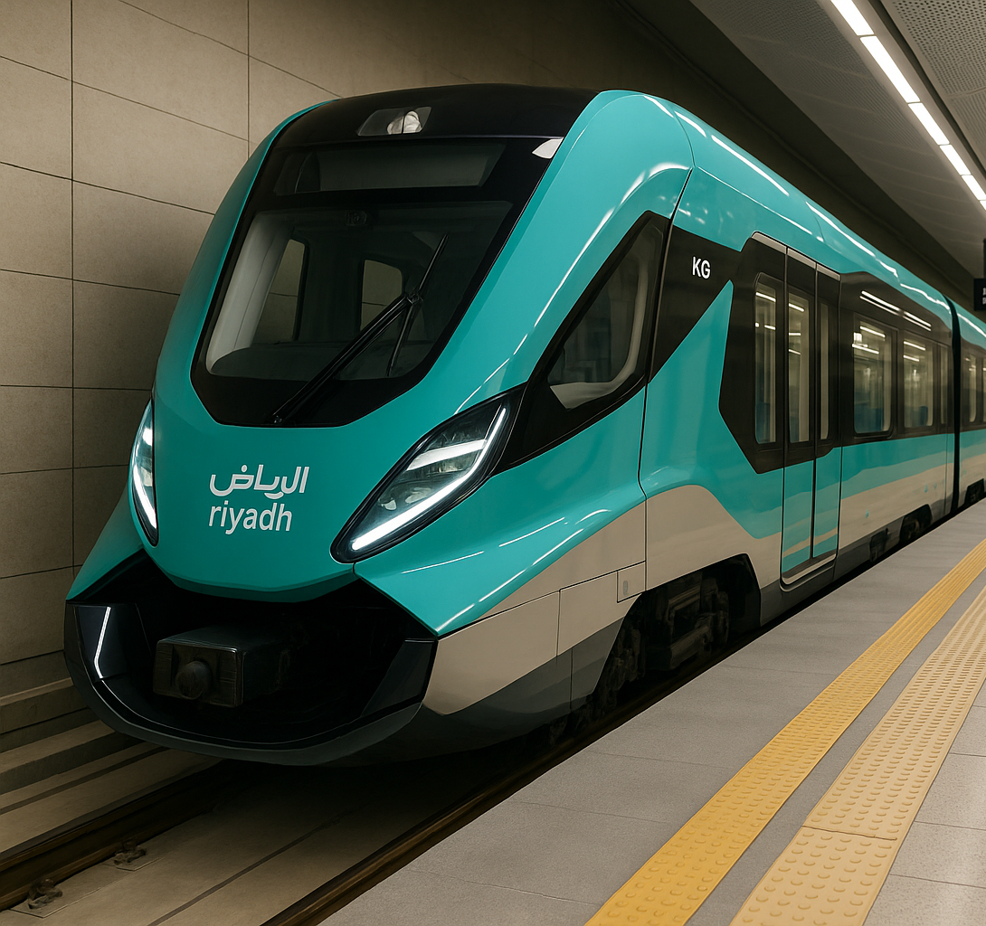
Customer
Analysis

Slide 7
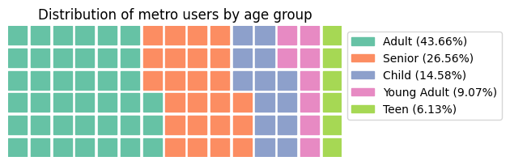
What age group uses
the metro the most?

Slide 8
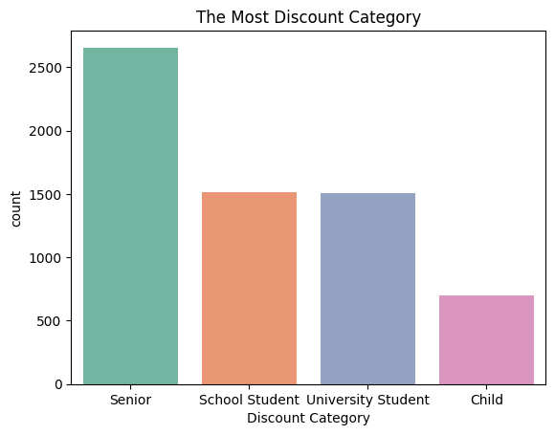
Which category get
the most discounted tickets?

Slide 9




Male
OR
Female
50.6%
49.4%

Slide 10

Time Analysis

Slide 11
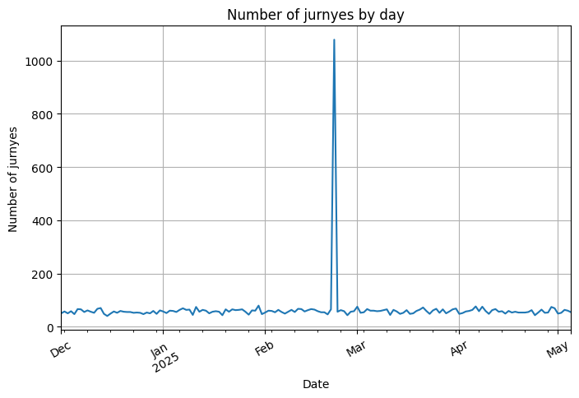
Are there certain months or days that witness an increase in journeys?

Slide 12
Special Focus: February 22 (Foundation Day)
Ridership Spike
Significant increase in ticket sales and journeys.

Slide 13
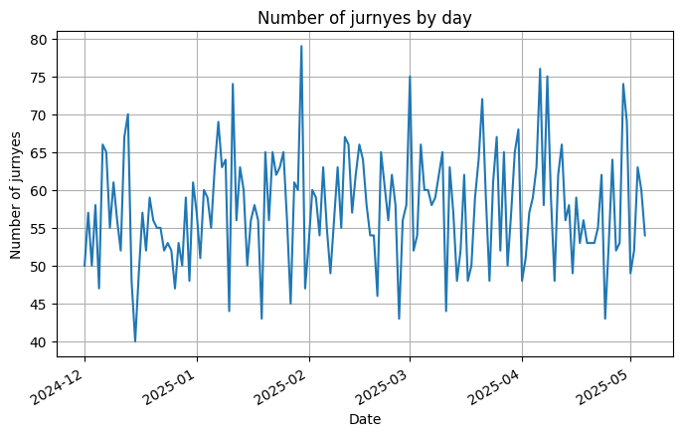
(excluding Feb 22) using a line chart.

Slide 14
The most popular day for Journeys is Monday

Slide 15
Price and revenue
Analysis

Slide 16



The most sold ticket
25.64%
Of 7 Days
Tickets
The average final price of the ticket is 58.99 SAR

Slide 17


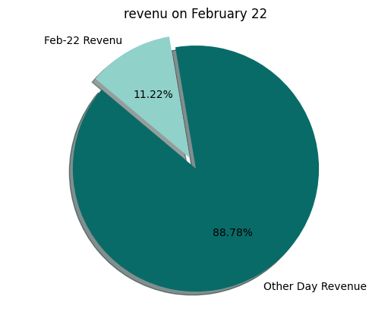
Revenue on February 22 of the total revenues
11.22%

Slide 18
Payment method
Analysis

Slide 19


Apple Pay is most commonly used payment method
25.21%
prefer to buy tickets from the ticket office

Slide 20
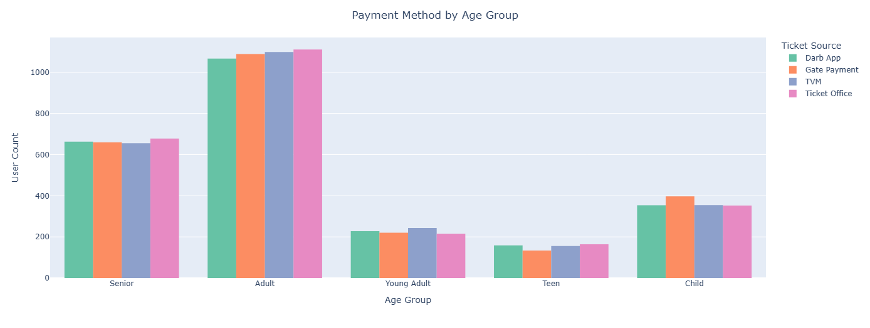
Payment Method by Age group
Adult
Teen
Ticket Office
Senior
Young Adult
TVM
Child
Gate Payment

Slide 21
Journeys
Analysis

Slide 22
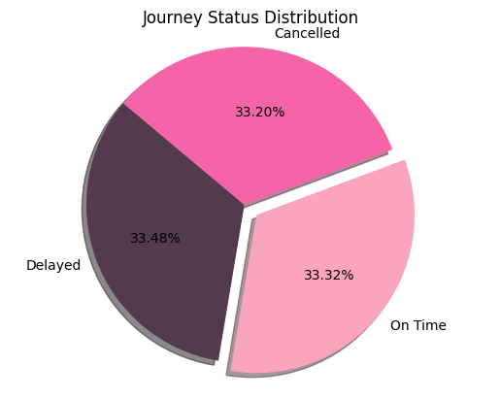
What is the percentage
of journeys that arrived on time compared to delayed or canceled journeys?

Slide 23




Maintenance
The most common cause of journey delays
66.8%
Of No Refund Requests

Slide 24
Recommendations

Slide 25



Direct marketing efforts towards
the Adult age group
as they represent the highest percentage of metro users.
Enhance discount programs for the Senior group
and ensure easier access to metro services.
Maintain balanced services for both genders
given the close usage rates between males and females.

Slide 26



Increase operational readiness during
special occasions
such as Founding Day, due to noticeable spikes in ridership.
Improve service quality on Mondays
as it’s the busiest day of the week.
Focus on promoting 7-day tickets
and encourage long-term subscription options.

Slide 27


Address delays caused by
maintenance
by improving scheduling and task distribution.
Support digital payment methods
especially Apple Pay
due to its high usage rate.
Review the current average ticket price
to ensure it matches the value provided.

Slide 28
Maintain customer satisfaction
especially among those who did not request refunds, and analyze refund requests to enhance future service.

Slide 29
Riyadh Metro
Ticket Sales
Data Analysis
Thanks For Listening

